Slide 1
Generative Adversarial Network
Dr. Yan Yan

Slide 2
NIPS 2016 Tutorial: Generative Adversarial Networks
Author: Ian Goodfellow
Paper: https://arxiv.org/abs/1701.00160
Video: https://channel9.msdn.com/Events/Neural-Information-Processing-Systems-Conference/Neural-Information-Processing-Systems-Conference-NIPS-2016/Generative-Adversarial-Networks
You can find tips for training GAN here: https://github.com/soumith/ganhacks

Slide 3
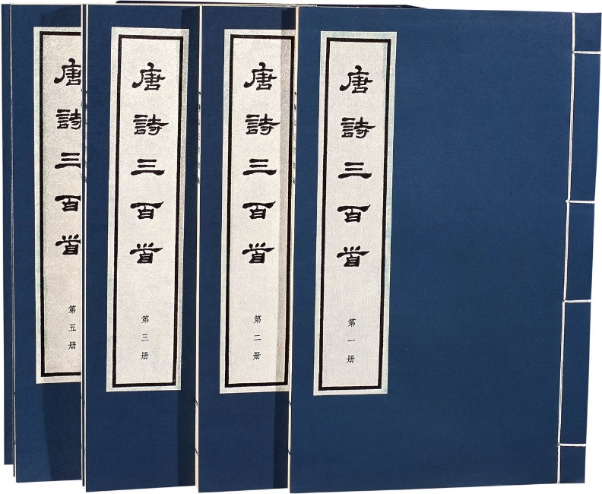












Generation
Writing Poems?
Drawing?
http://www.rb139.com/index.php?s=/Lot/44547

Slide 4

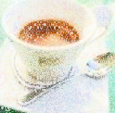
Auto-encoder
As close as possible
NN
Encoder
NN
Decoder
code
Randomly generate a vector as code
NN
Decoder
code
Image ?

Slide 5



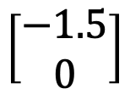
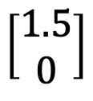
Auto-encoder
2D
NN
Decoder
code
NN
Decoder
$$\left[\begin{aligned}1.5 \\ 0\end{aligned}\right]$$
-1.5
1.5
$$\left[\begin{aligned}−1.5 \\ 0\end{aligned}\right]$$
NN
Decoder

Slide 6
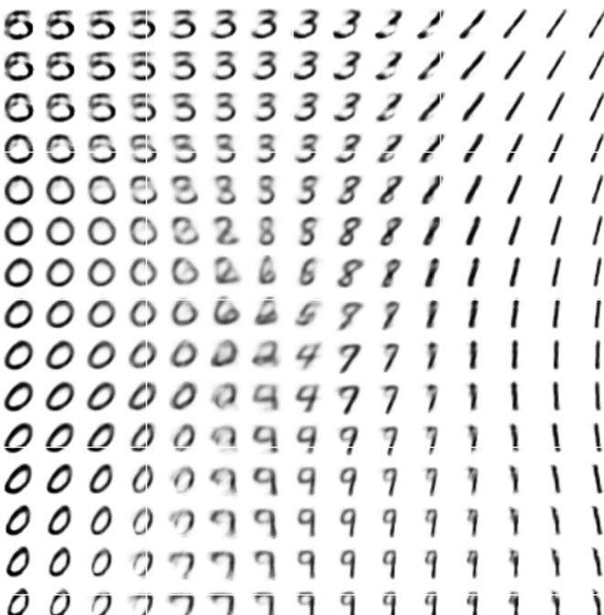
Auto-encoder
-1.5
1.5

Slide 7






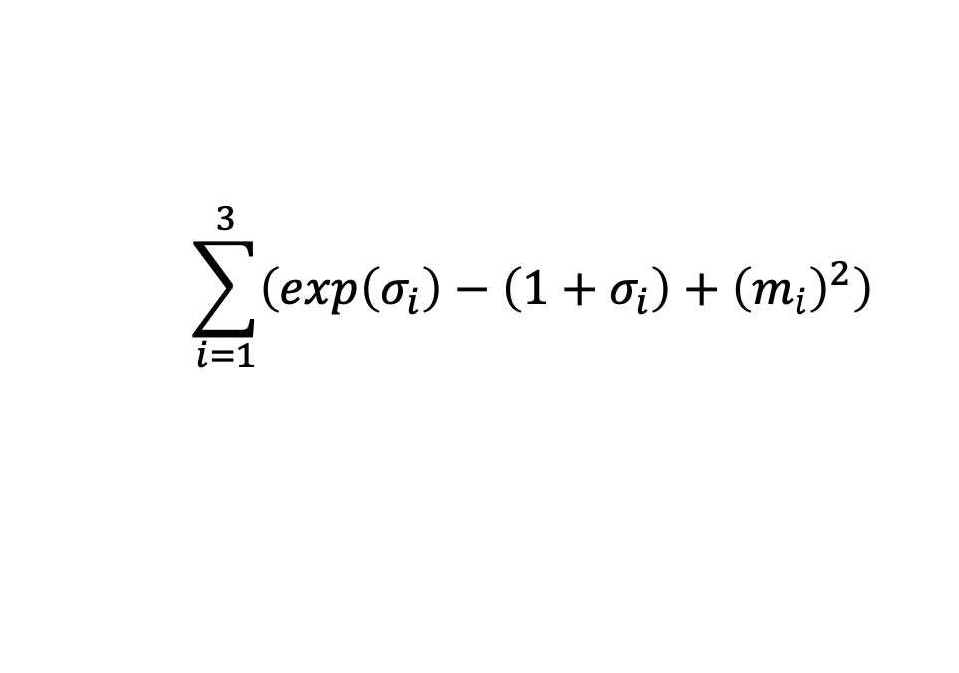




AE vs VAE
Auto-encoder
NN
Encoder
NN
Decoder
input
output
code
VAE
Minimize reconstruction error
m₁
m₂
NN
Encoder
m₃
$$c_{1}$$
NN
Decoder
input
output
$$σ_{1}$$
exp
+
$$c_{2}$$
$$σ_{2}$$
$$c_{3}$$
$$σ_{3}$$
X
$$c_{i}=exp\left(σ_{i}\right)×e_{i}+m_{i}$$
From a normal distribution
$$e_{1}$$
$$e_{2}$$
Minimize
$$e_{3}$$
$$\sum_{i=1}^{3}{\left(exp\left(σ_{i}\right)−\left(1+σ_{i}\right)+{\left(m_{i}\right)}^{2}\right)}$$
Auto-Encoding Variational Bayes, https://arxiv.org/abs/1312.6114

Slide 8

Problems of VAE
It does not really try to simulate real images
code
NN
Decoder
Output
As close as possible
One pixel difference from the target
One pixel difference from the target
Realistic
Fake

Slide 9


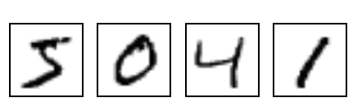
The evolution of generation
NN
Generator
v1
NN
Generator
v2
NN
Generator
v3
Discri-minator
v1
Discri-minator
v2
Discri-minator
v3
Binary
Classifier
Real images:

Slide 10
GAN - Discriminator
NN
Generator
v1
Randomly sample a vector
0
0
0
0
Something like Decoder in VAE
Real images:
1
1
1
1
image
Discri-minator
v1
(real or fake)
1/0

Slide 11


GAN - Generator
Randomly sample a vector
NN
Generator
v1
Updating the parameters of generator
v2
The output be classified as “real” (as close to 1 as possible)
Generator + Discriminator = a network
Discri-minator
v1
Using gradient descent to update the parameters in the generator, but fix the discriminator
1.0
0.13

Slide 12
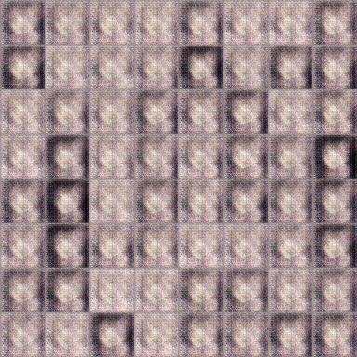
GAN – Image Generation
100 rounds

Slide 13
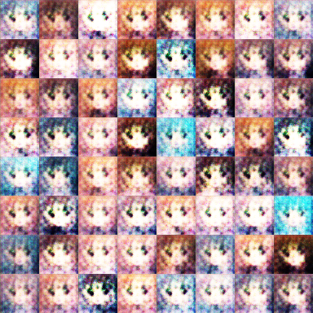
GAN – Image Generation
1000 rounds

Slide 14
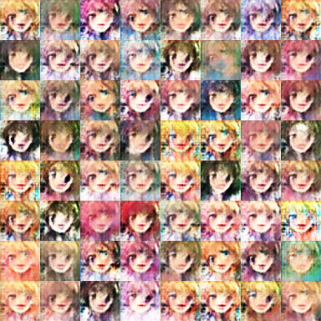
GAN – Image Generation
5000 rounds

Slide 15
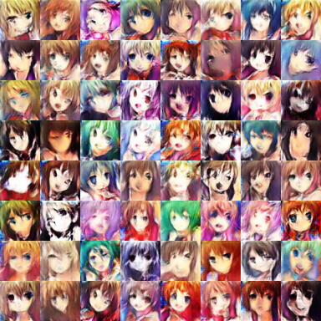
GAN – Image Generation
10,000 rounds

Slide 16
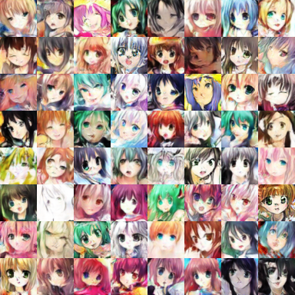
GAN – Image Generation
50,000 rounds

